Slide 1
AUTOMATED
ESSAY GRADING
Using Long Short Term Memory Networks
Anmol Preet Singh 2K18/SE/027
Chitra Singla 2K18/SE/048

Slide 2
INTRODUCTION
Automated Essay Grading or Scoring consists of automatic evaluation of the score or grade of a written essay. The system is motivated by the need to develop solutions for helping teachers to grade essays in an efficient and effective manner. The system is also useful for the students to understand issues in their writing by receiving quick and effective feedback from a system rather than waiting for inputs from a teacher.

Slide 3
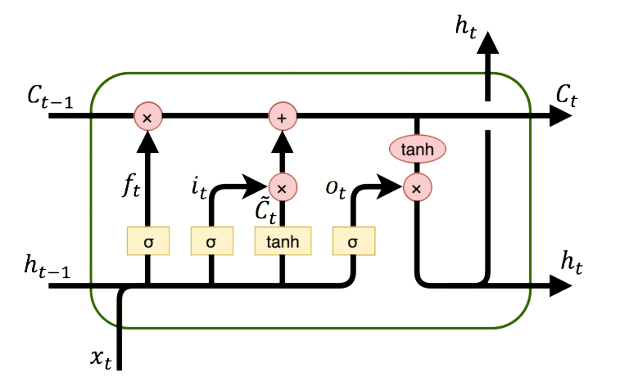




PROJECT TIMELINE
Data
Preprocessing
Reproducible
Research
02
04
01
03
05
Data
Acquisition
Exploratory
Data Analysis
Comparative
Analysis
Word2Vec
GLoVe
FastText

Slide 4
DATA PRE-PROCESSING
Attribute Reduction
Removal of empty and partially filled columns.
Feature Vectors
The Dataset
Data Cleaning
Essays are first tokenized into sentences then into words. After that feature vectors are made from wordlist using Word2Vec, Glove and FastText models.
The Dataset contains around 13000 essays in group of 8 sets, written by american students of grade 7 -10.
Each essay having 150-550 words and graded in the range of 0-60.
It involves removal of tagged labels used for identifiers and removal of stopwords using NLP Library.
There were no outliers present.

Slide 5
WORD EMBEDDINGS
W2V
Word2Vec
FsTxT
FastText
GloVe
GloVe
Word embedding is a type of word representation that allows words with similar meaning to be understood by machine learning algorithms. They help in feature generation, document clustering, text classification, and natural language processing tasks.
GloVe (Global vectors for word representation) is based on matrix factorization techniques on the word context matrix. In this, for each term, we look for context terms within some area defined by a window-size before and after the term in our corpus and less weight is given for more distant words.
It is trained on the Wikipedia dataset which consists of around 6 billion words.
Word2vec is a model to produce word embedding for word representation. It captures a large number of precise syntactic and semantic word relationships. It is a shallow two-layered neural network and represents words in vector space representation. It reconstructs the linguistic context of words.
Pre-trained Word2vec is trained on Google news dataset which consists of around 100 billion words.
Fasttext words embedding is similar to word2vec by Facebook research team and it also contains embeddings for n-grams which help in data sets with out of vocabulary words.
FastText is trained on a wiki news dataset and contains around 1 million word vectors.

Slide 6
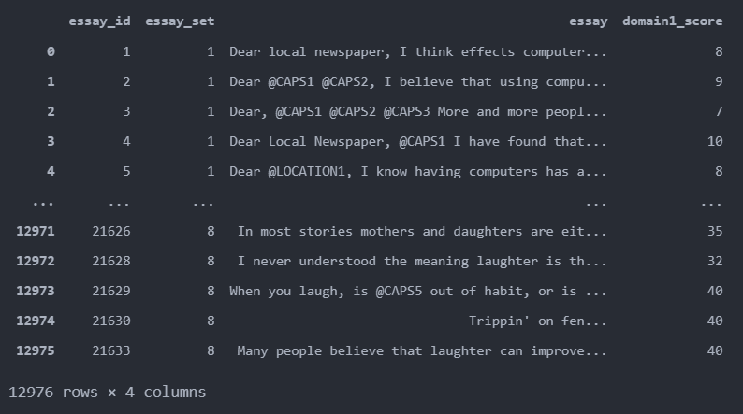
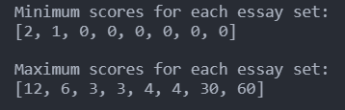
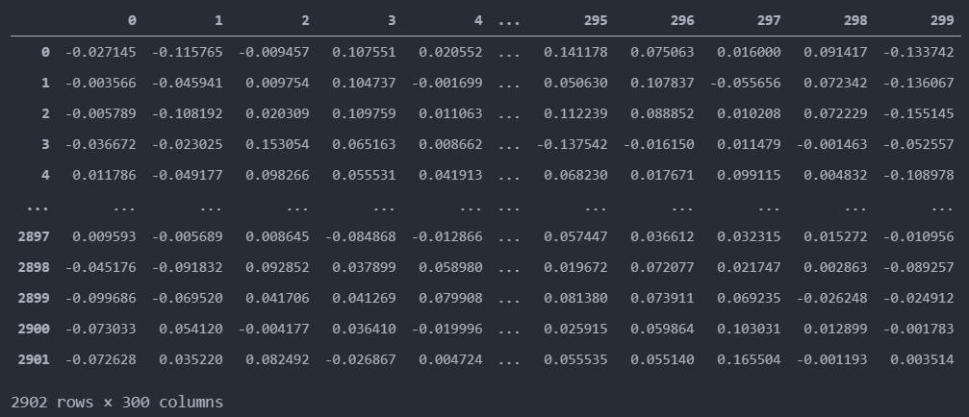
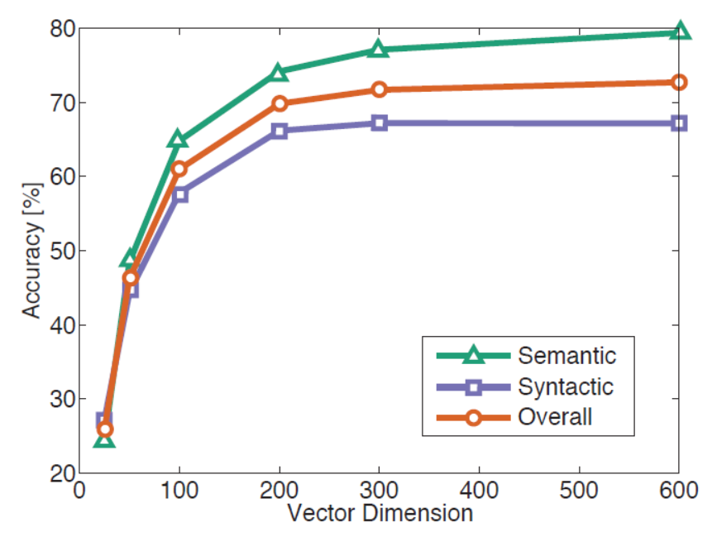
PROCESSED DATASET
After pre-processing of data our final dataframe is prepared with respective minimum and maximum scores for each essay set. And word embeddings are made from all features( words ) extracted from the corpus.

Slide 7
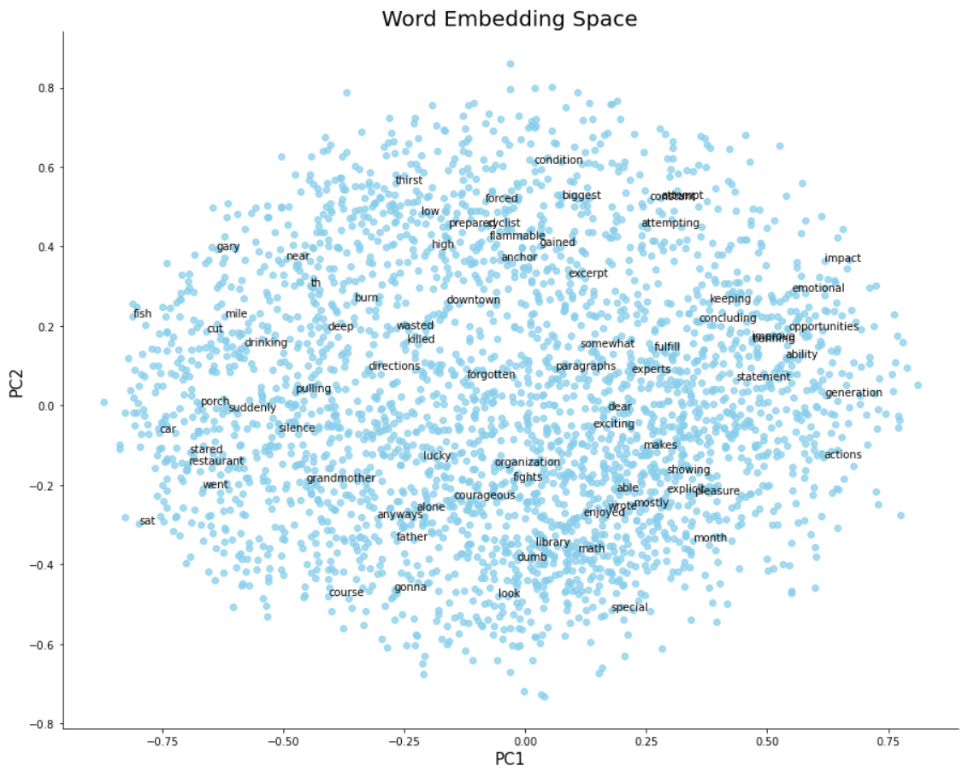
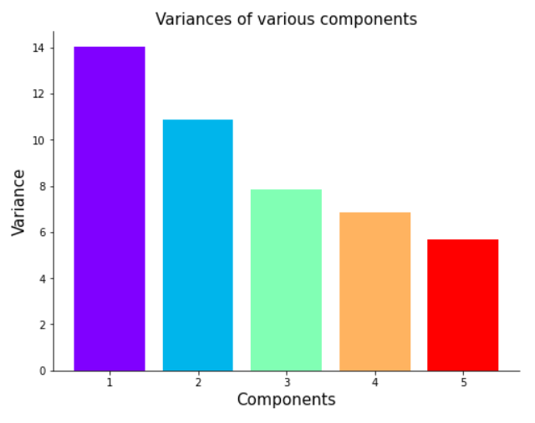
EXPLORATORY DATA ANALYSIS
Principal Component Analysis (PCA)
It is an unsupervised statistical and data correlation technique that is used to simplify data of higher dimensions into lower Dimensions.
PCA searches for a linear combination of variables
so that we can extract maximum variance from the
Variables. In this method, we analyze total variance.

Slide 8
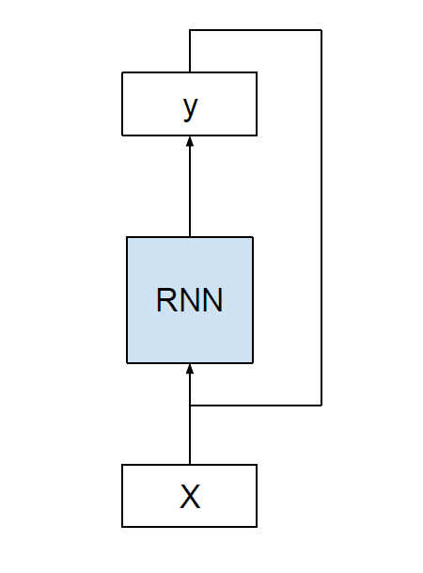
REPRODUCIBLE RESEARCH
RNN - Recurrent Neural Networks suffer from short-term memory and if the sequence is very long, they do not carry earlier information to the next time steps and may leave out important information while processing.
RNN also suffers from vanishing gradient problems during the backpropagation, which means that the gradient shrinks as the network back propagates. They will not make any changes in the weights and hence do not contribute much.
MLP - The multilayer perceptron is a feed-forward artificial neural network that uses backpropagation as a supervised learning technique.
MLPs learn fixed-function approximation and are unaware of the temporal structure of the input.
The size of the sliding window is fixed in them and must be imposed on all inputs to the network. The size of the output is also fixed and any outputs that do not conform must be forced.
So their rigid behavior makes them more useful in normal classification problems instead of text classification.
LSTM - The Long Short-Term Memory (LSTM) network is a type of Recurrent Neural Network which is designed for solving sequence related problems. An essay is a sequence of words and the meaning of a sentence is defined by the sequence only, if the sequence of words changes then the meaning will also change. So, it is a type of sequence classification problem. Therefore, we will be using Long Short Term Memory Networks.

Slide 9
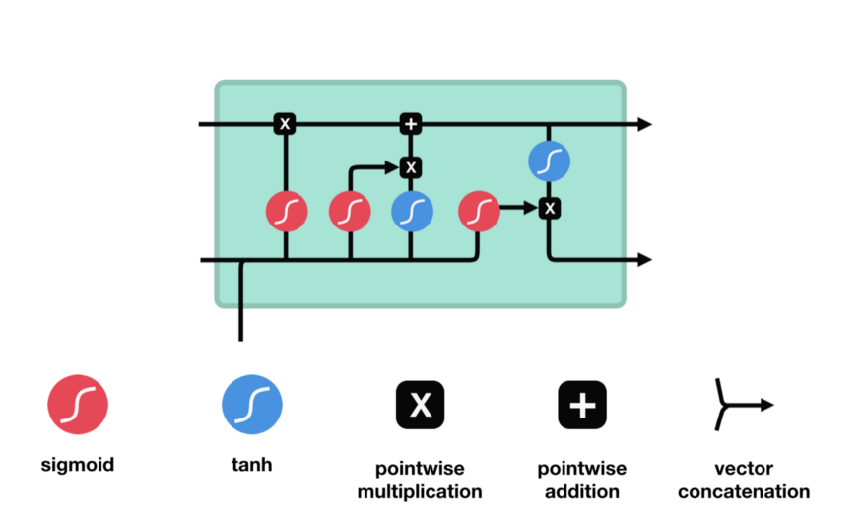
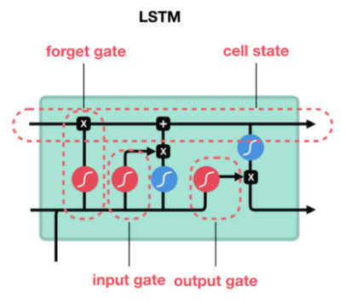
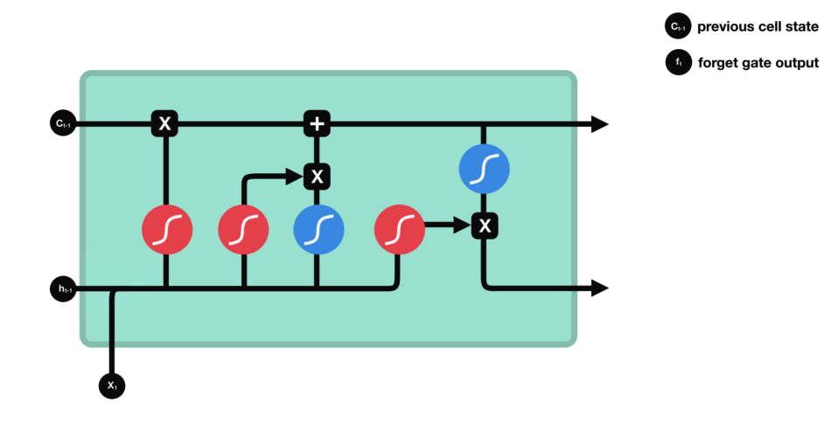
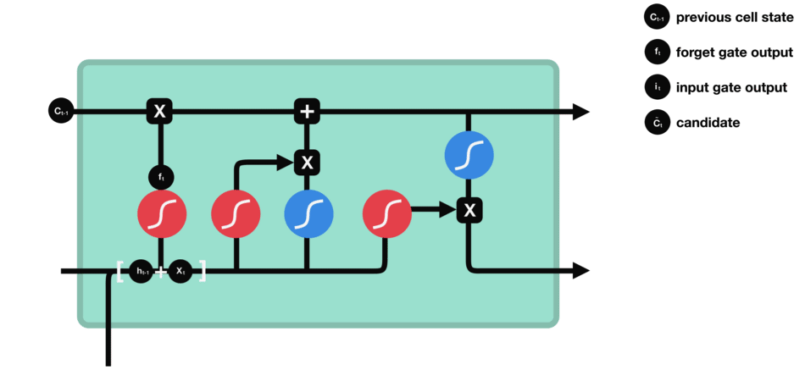
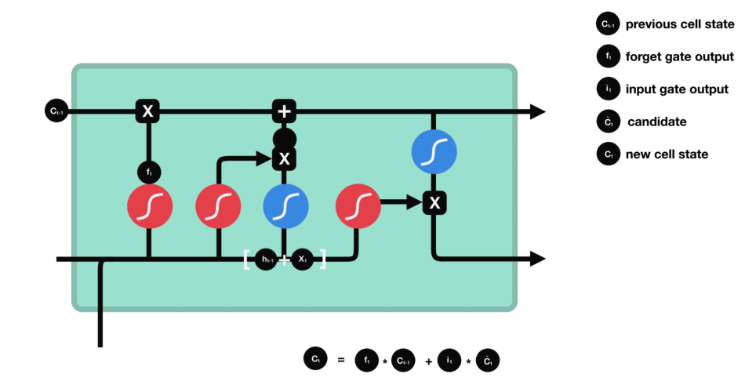

WORKING OF LSTM NETWORKS

Slide 10
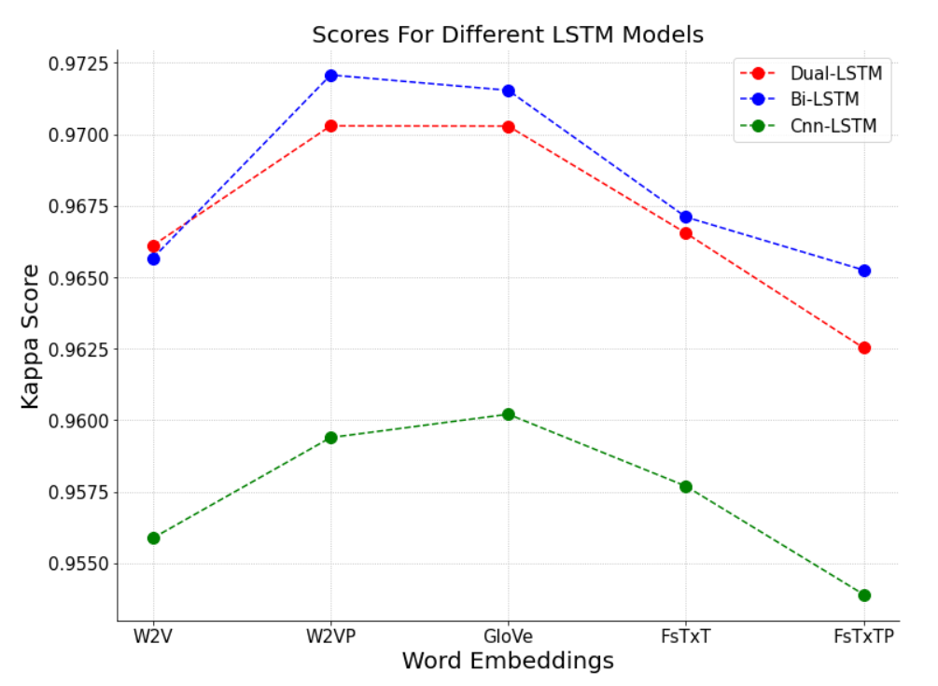
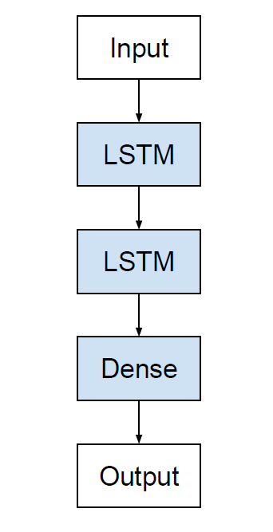
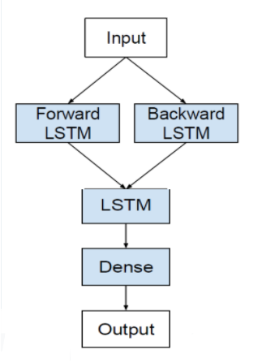
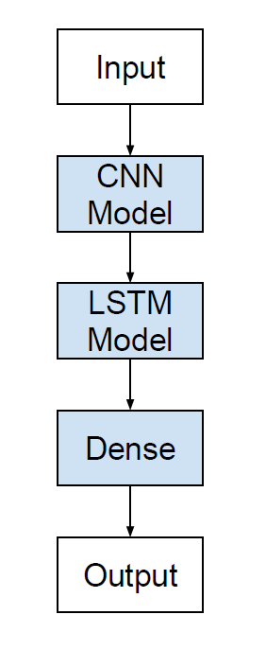
COMPARATIVE ANALYSIS
 | W2V | W2VP | GloVe | FsTxT | FsTxTP
Dual-LSTM | 0.966 | 0.970 | 0.970 | 0.967 | 0.963
Bi-LSTM | 0.966 | 0.972 | 0.971 | 0.967 | 0.965
Cnn-LSTM | 0.956 | 0.959 | 0.958 | 0.960 | 0.954
Bi - LSTM Model performed best with pre-trained word2vec

Slide 11
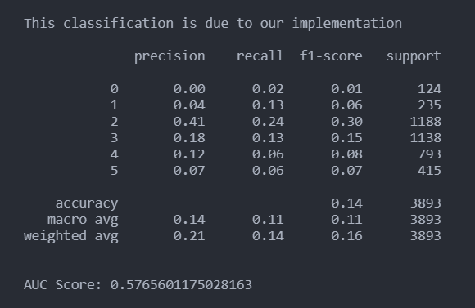
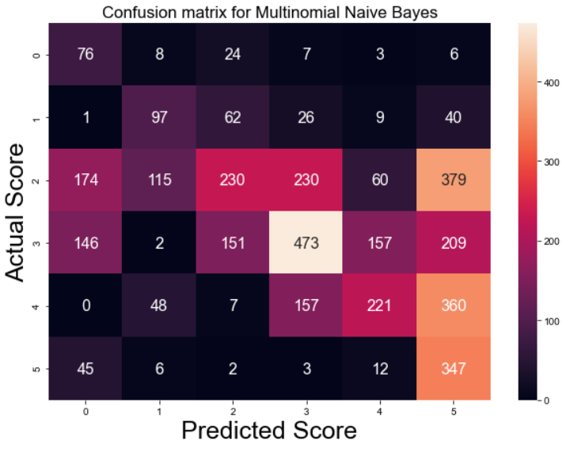
MULTINOMIAL NAIVE BAYES FROM SCRATCH
AUC Score - 0.577
We performed naive bayes on the basis of frequency of most frequent words used in our vocabulary after removing stopwords.
We formed the vocabulary of 3000 most frequent words used in the whole corpus. Then defining every essay on the basis of frequency of these words present in each one of them.

Slide 12
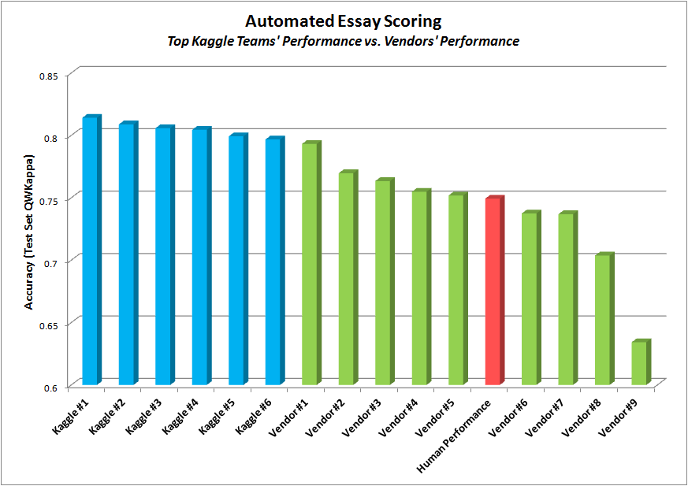
NOVELTY AND RELATED WORK
Alikaniotis, Yannakoudakis, Rei
Nguyen, Dery
OUR PROJECT
Models used :
SVM, LSTM, BiLSTM, Two-Layer LSTM
Word Embedding :
Word2Vec, SSWE
Kappa score : 0.96
Models used :
Dual-Layer LSTM, BiLSTM, CNN LSTM
Word Embedding :
Word2Vec, GloVe, FastText
Kappa score : 0.97207
Models used :
Two-Layer NN, BiLSTM, Deep LSTM
Word Embedding :
GloVe, TF IDF
Kappa score : 0.94478

Slide 13
CONCLUSION AND FUTURE WORK
1
2
3
Automated essay grading is a very important application of machine learning and natural language processing. The system gives the best score of 0.972073 on the Quadratic mean average kappa metric and the best kappa score of the winner of the competition was 0.81407. This score is achieved by the Bi-directional LSTM model using 300 dimensional pre-trained word2vec embedding layer and it shows the vast potential of neural networks to solve natural language processing problems.
Doc2Vec
InferSent
Universal Sentence Encoder by Google

Slide 14
THANK
YOU

